Slide 1


Slide 2



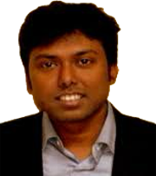


1
Team 2 – Session 11:30 AM
World Happiness & The Global Economy– Visual Analytics
Nikolai Saporoschetz
Alexander Scarcelli
Hummarah Shahzad
Avishek Dasgupta
Samarth Bansal
Siddhant Treasure
Notes:
Team intro

Slide 3

Notes:
Opening slide and ask audience to guess the topic

Slide 4

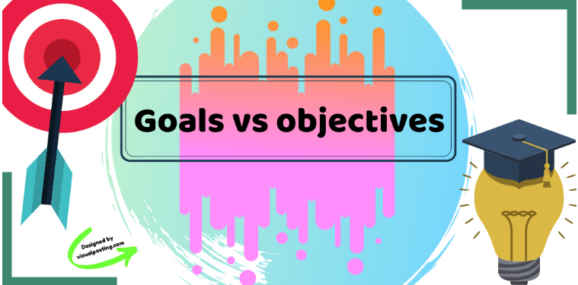
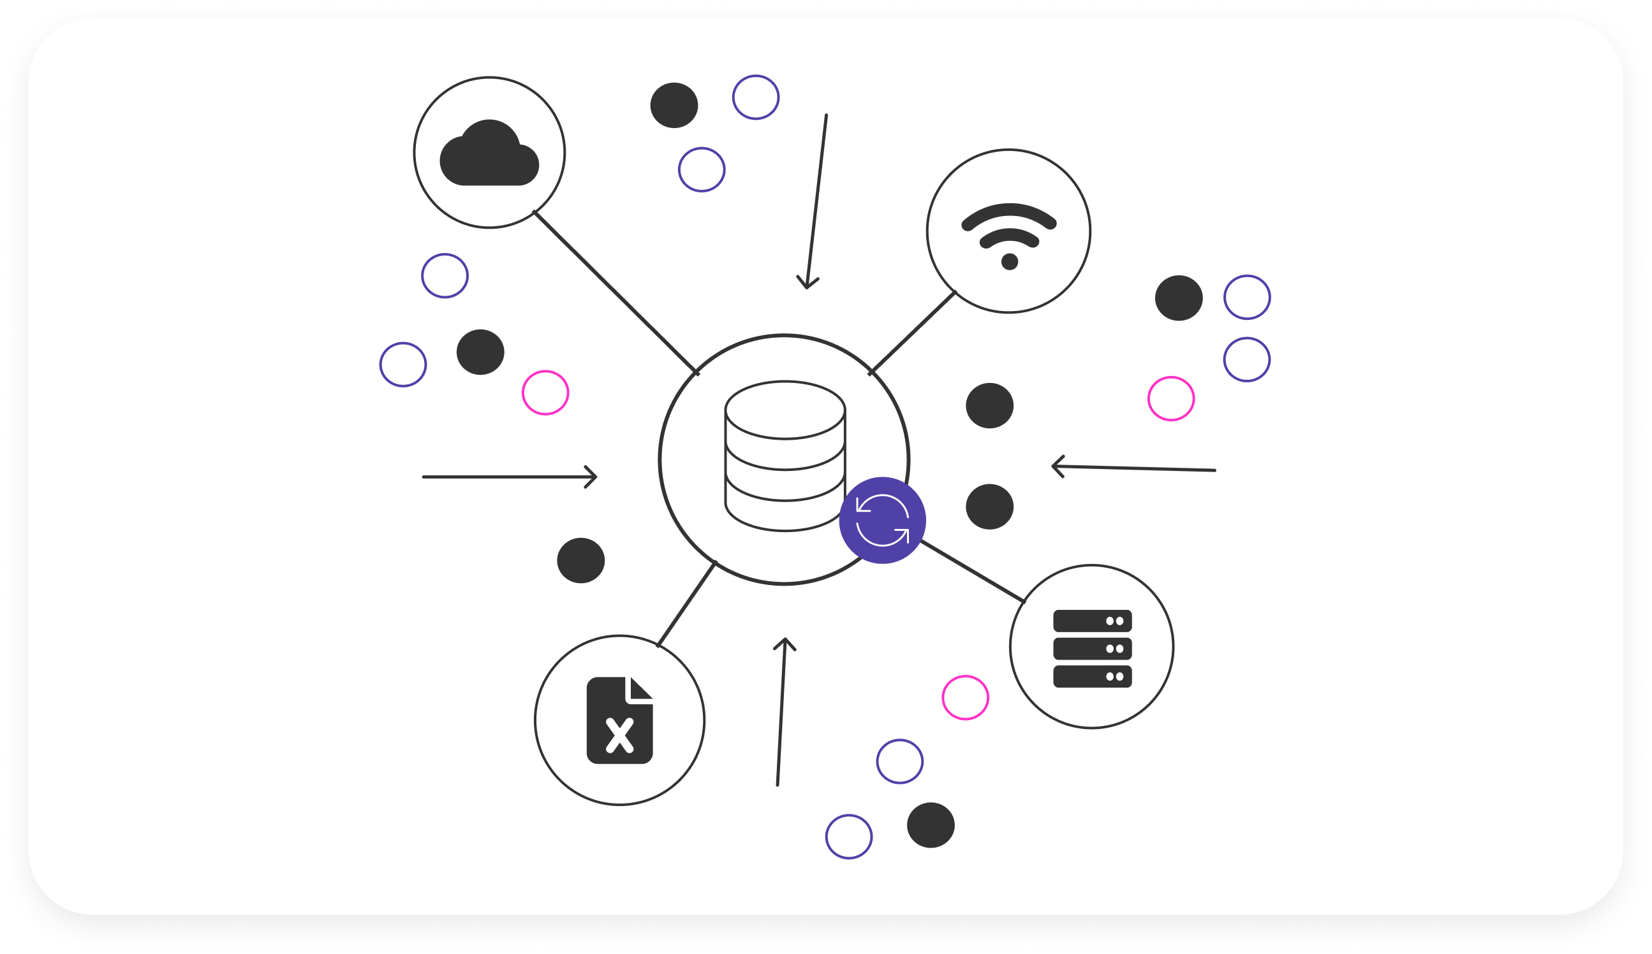
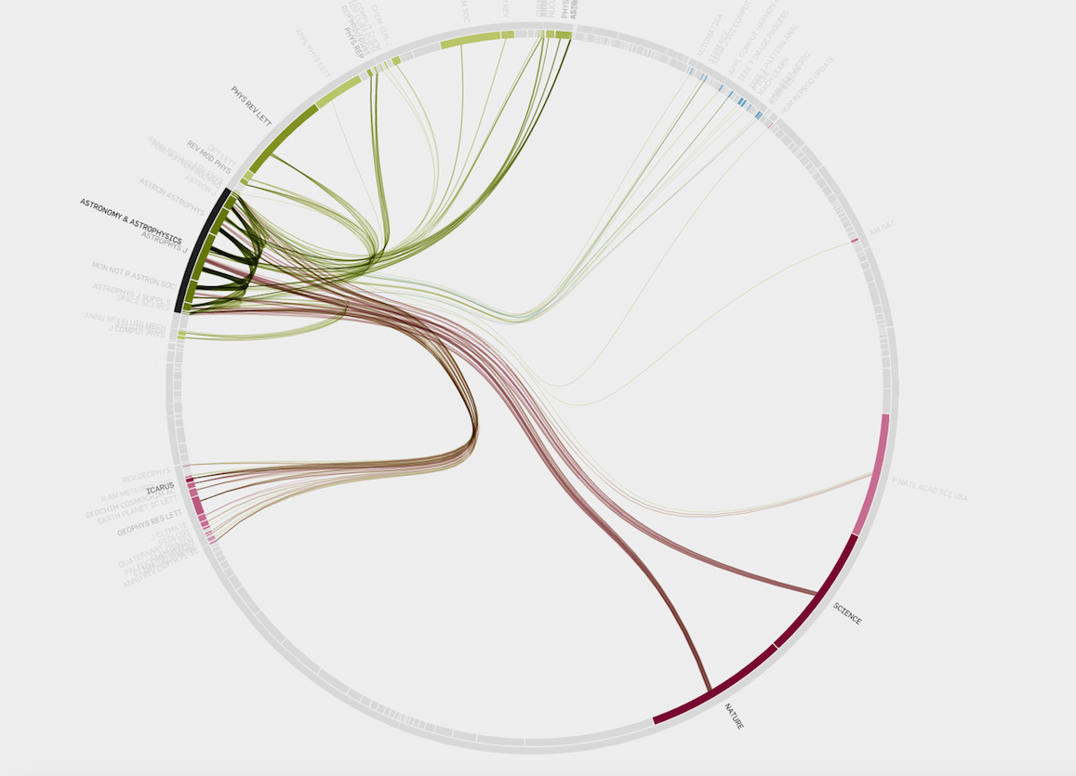

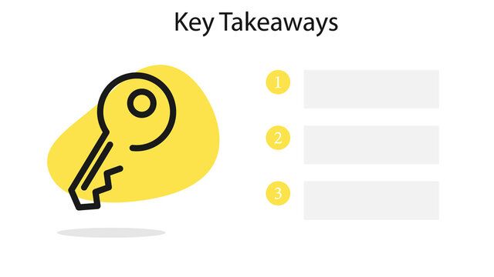
1
Agenda
Project Map
World Happiness & The Global Economy– Visual Analytics
1
2
3
4
5
Introduction
& Background
Objectives & Goals
Data Set Information
Visualization Plan
Project
Findings
Key
Takeaways
Notes:
Presentation Flow

Slide 5


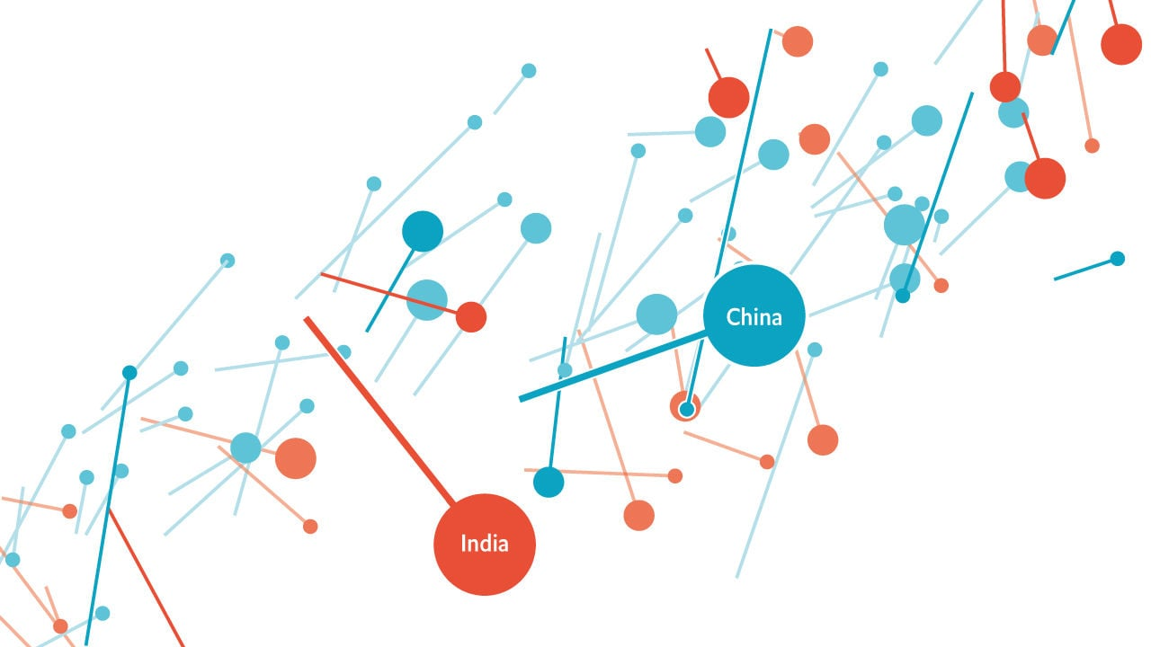
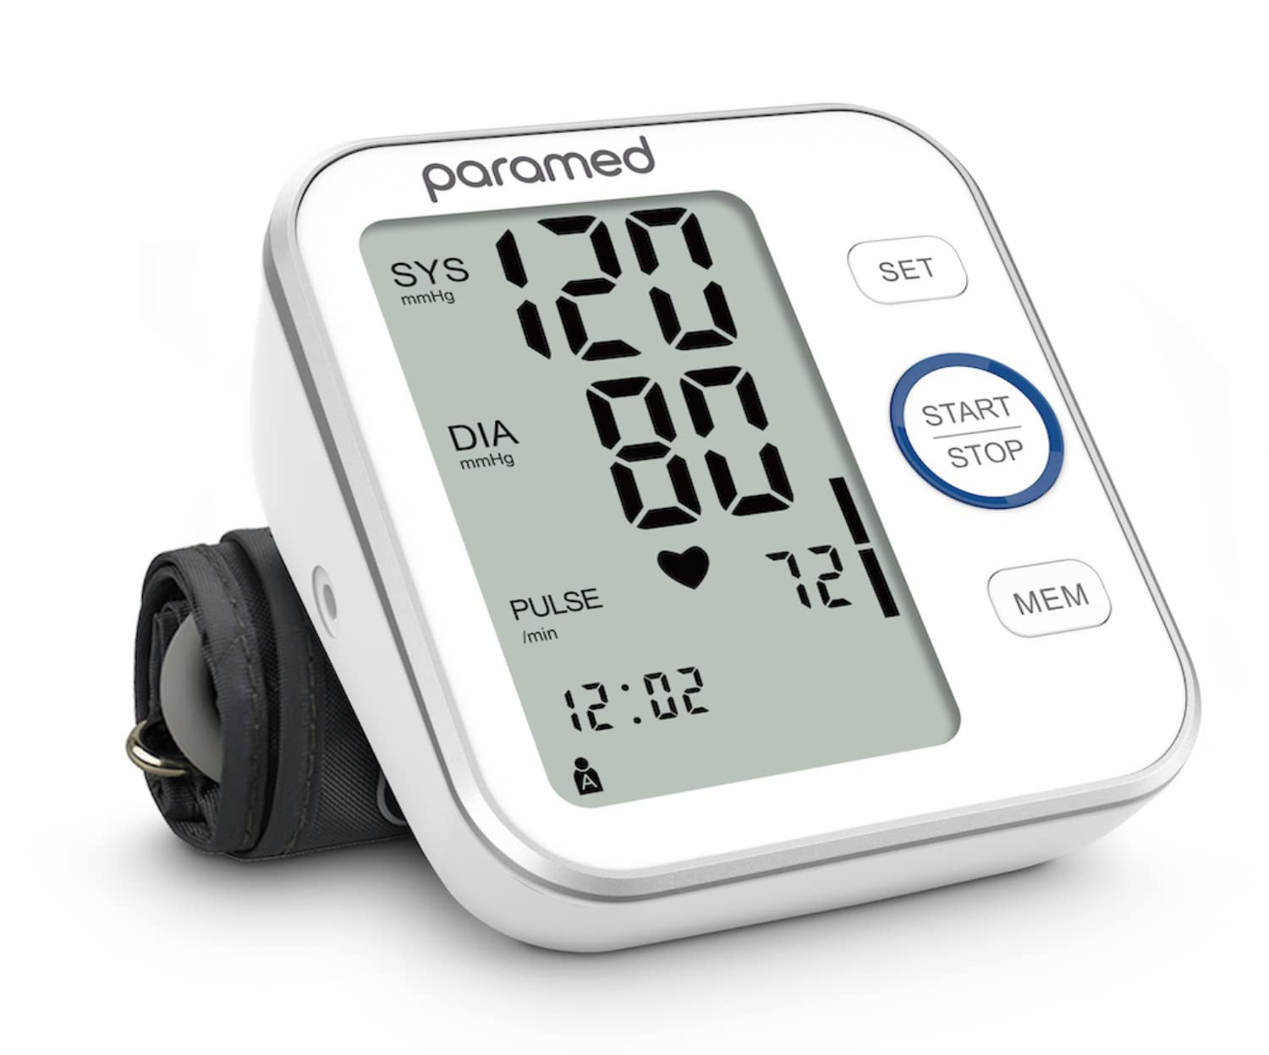



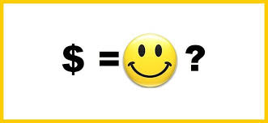
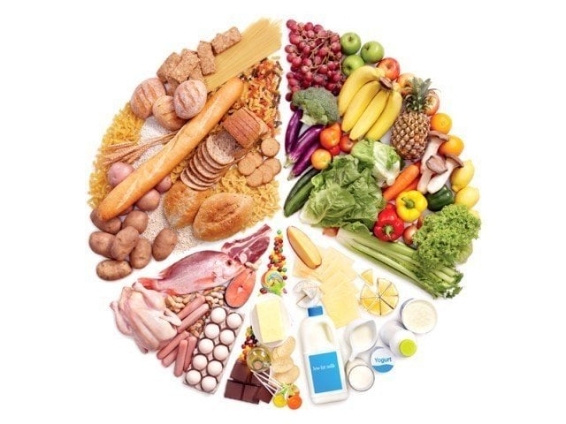
1
Introduction & Background
World Happiness & The Global Economy– Visual Analytics
Happiness impacts health & productivity?
Determinants of Happiness?
Reduces Risk of Cardiovascular
diseases
Improves blood pressure
Allows better sleep
Improves our diet
Our motivation for choosing this topic originated from our interest in determining whether economic or social factors played a larger role in determining a country’s level of happiness
Notes:
Presentation Flow

Slide 6
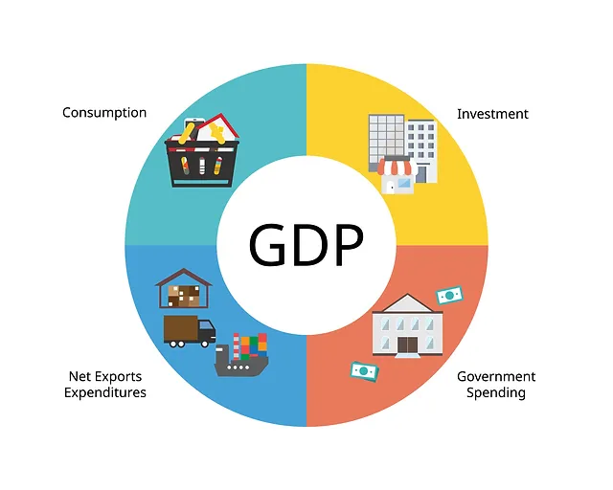

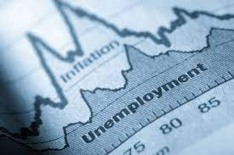
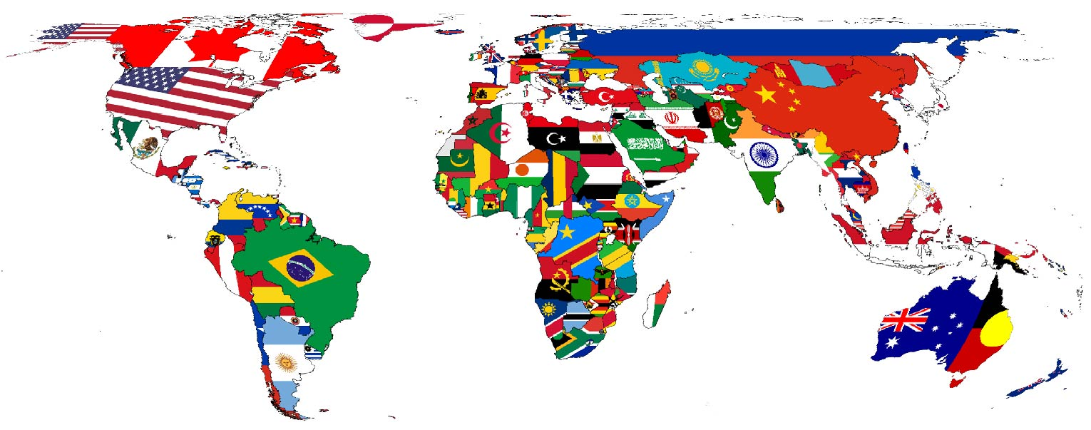

1
Objectives & Goals
World Happiness & The Global Economy– Visual Analytics
Assess Relationship between
Socio Economic Indicators & Happiness
Other factors such as education, unemployment & political stability influencing country's happiness
Comparison across nations to understand if similar patterns exist
Objective of the project is to understand the relationship between happiness and other socio-economic indicators while identifying if there are other variables affecting the happiness score & the trend across nations
Notes:
Presentation Flow

Slide 7
1
Objectives & Goals
World Happiness & The Global Economy– Visual Analytics
1
Assess Relationship between Socio Economic Indicators & Happiness
2
Identify other factors such as education, unemployment, human development index, political stability influencing the country’s happiness.
3
Comparison across nations to understand if similar patterns exist in different countries
Notes:
Presentation Flow

Slide 8

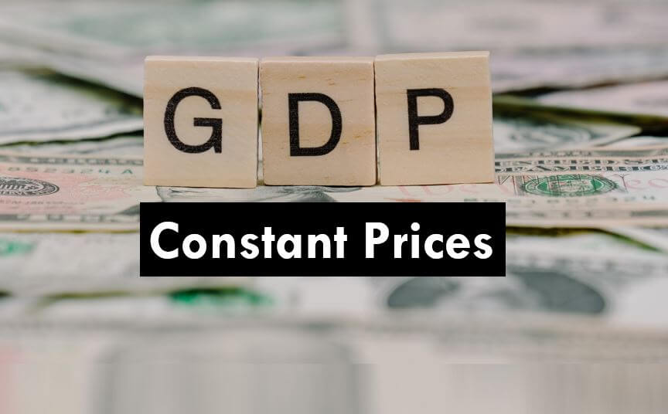

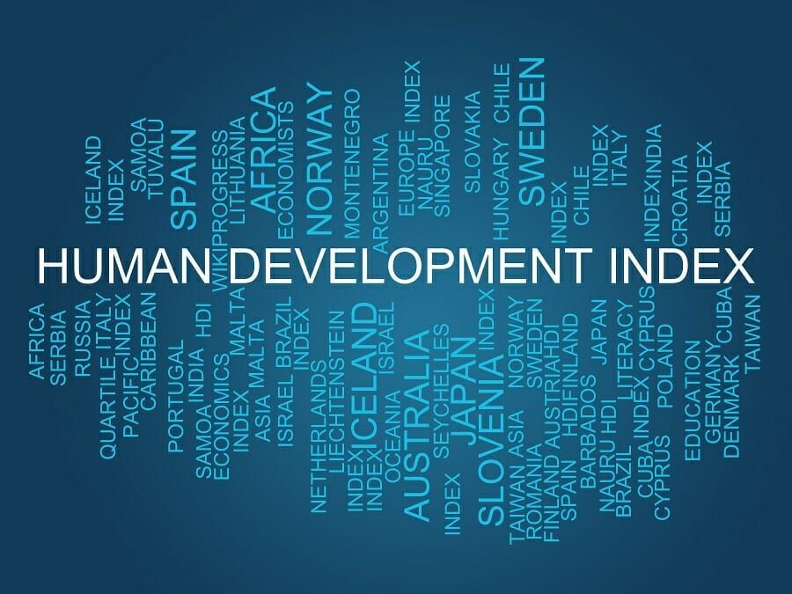
Data Set Information
World Happiness & The Global Economy– Visual Analytics
World Happiness Report
Source: United Nations World Happiness Report. Accessed on Kaggle.
Timeline: 2013 – 2023
Columns: Country, Year, Index, Rank
Rows: 1,660
GDP Current Prices
Source: UNDP Website (United Nations Development Program)
Timeline: 2018 – 2023
Columns: Country, Year, GDP
Rows: 1804
Unemployment Data
Source: IMF (International Monetary Fund)
Timeline: 2018 – 2022
Columns: Country, Year, Unemployment Rate
Rows: 515
Human Development Index
Source: UNDP Website (United Nations Development Program)
Timeline: 1889 – 2018
Columns: Country, ISO-3 Code, Year, Human Development Index
Rows: 7,080

Slide 9
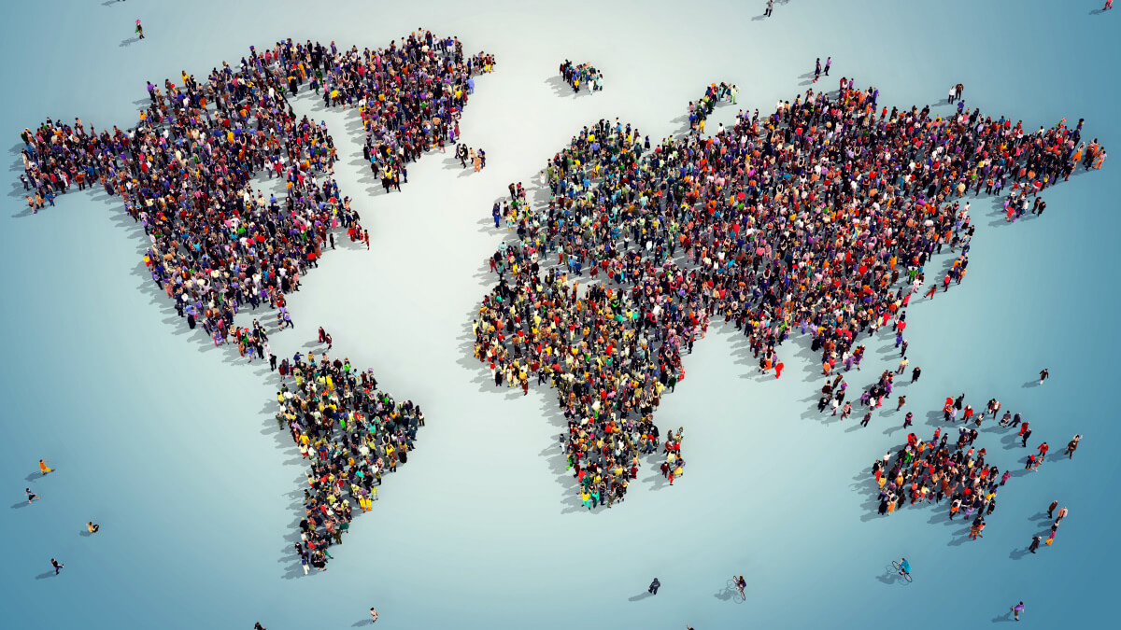
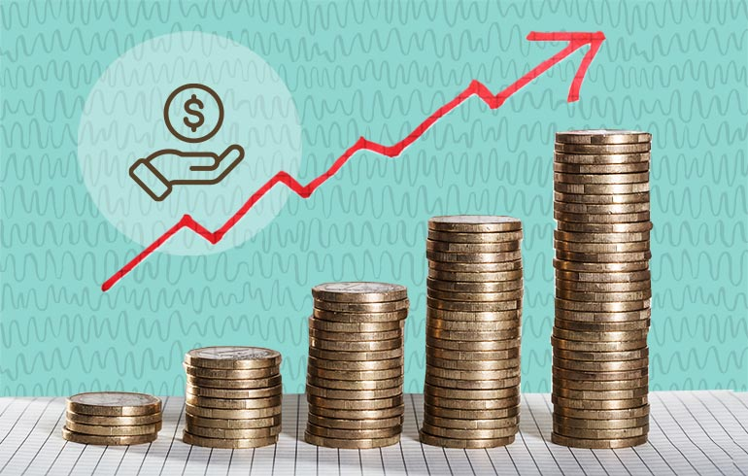

Data Set Information
World Happiness & The Global Economy– Visual Analytics
Political Stability
Source: UNDP Website (United Nations Development Program)
Timeline: 2018 – 2022
Columns: Country Name, Country Code, Indicator Definition, Indicator Code, 2018-2022 Stability Rankings
Rows: 212
Population
Source: IMF (International Monetary Fund)
Timeline: 2018 -2022
Columns: Country, Year, Population
Rows: 755
Inflation
Source: IMF (International Monetary Fund)
Timeline: 2018- 2028
Columns: Country Name, 1980-2028 YoY inflation (Individual by years
Rows: 227
Education Inequality
Source: UNDP Website (United Nations Development Program)
Timeline: 2010 -2021
Columns: ISO-3, Country, Human Development Group, UNDP Developing Regions, HDI Rank, Inequality in Education (Columns for 2010 to 2021)
Rows: 195

Slide 10
Data Set Information
World Happiness & The Global Economy– Visual Analytics
Data Set 1: World Happiness Report
Source: United Nations World Happiness Report. Accessed on Kaggle.
Timeline: 2013 to 2023
Composition:
Columns: Country, Year, Index, Rank
Rows: 1,660
Description: A subjective ranking of 0-10 for 166 countries within the 10-year timeframe. The rankings are from nationally representative samples over three years.

Slide 11
Data Set Information
World Happiness & The Global Economy– Visual Analytics
Data Set 2: GDP Current Prices
Source: UNDP Website (United Nations Development Program)
Purpose: To get the correlation between economic GDP indicators. To compare the sum of gross value added by all resident producers in the economy between the nations.
Timeline: 2018 to 2028
Composition:
Columns: Country, Year, GDP
Rows: 1804
Description: Shows GDP For Each Country By Year (2018-2028)

Slide 12
Data Set Information
World Happiness & The Global Economy– Visual Analytics
Data Set 3: Countries
Source: World Happiness Report
Purpose: To establish a reference table for outside economic and social data used for our analysis.
Timeline: N/A
Composition:
Columns: Country
Rows: 166
Description: A non-duplicated list of countries included in the World Happiness Report.

Slide 13
Data Set Information
World Happiness & The Global Economy– Visual Analytics
Data Set 4: Unemployment Data
Source: IMF (International Monetary Fund)
Purpose: To measure and compare the unemployment rate across countries. To measure the impact of unemployment rate on happiness index.
Timeline: 2018 to 2022
Composition:
Columns: Country, Year, Unemployment Rate
Rows: 515
Description: Shows Unemployment Rate For Each Country By Year (2018-2022)

Slide 14
Data Set Information
World Happiness & The Global Economy– Visual Analytics
Data Set 5: Human Development Index
Source: UNDP Website (United Nations Development Program)
Purpose: Created to establish a universally recognized index of average achievement by country across key dimensions. life expectancy, education and per capita income.
Timeline:1989 to 2018
Composition:
Columns: Country, ISO-3 Code, Year, Human Development Index
Rows: 7,080
Description: Shows the Human Development Index by country which combines life expectancy, education and per capita income into a single measurement ranging from 0 to 1 by country.

Slide 15
Data Set Information
World Happiness & The Global Economy– Visual Analytics
Data Set 6: Political Stability
Source: UNDP Website (United Nations Development Program)
Purpose: Created to rank political stability and the absence of terrorism by country.
Timeline: 2018 to 2022
Composition:
Columns: Country Name, Country Code, Indicator Definition, Indicator Code, 2018-2022 Stability Rankings
Rows: 212
Description: Shows the political stability rating of a country on a scale from 0-100 with a lower number indicating a higher level of instability.

Slide 16
Data Set Information
World Happiness & The Global Economy– Visual Analytics
Data Set 7: Population Data
Source: IMF (International Monetary Fund)
Purpose: To measure the total population growth/ decline by country over time. To measure impact of population density on happiness index.
Timeline: 2018 to 2022
Composition:
Columns: Country, Year, Population
Rows: 755
Description: Shows Total Population (In millions) For Each Country By Year (2018-2023)

Slide 17
Data Set Information
World Happiness & The Global Economy– Visual Analytics
Data Set 8: Inflation
Source: IMF (International Monetary Fund)
Purpose: Created to track year over year inflation across countries.
Timeline: 1980 to 2028 (Forecasted values after 2022)
Composition:
Columns: Country Name, 1980-2028 YoY inflation (Individual by year)
Rows: 227
Description: Shows the year over year inflation by country from 1980 to 2028.

Slide 18
Data Set Information
World Happiness & The Global Economy– Visual Analytics
Data Set 9: Inequality in Education
Source: UNDP Website (United Nations Development Program)
Purpose: Created to evaluate inequality in educational opportunities across countries over time.
Timeline: 2010 to 2021
Composition:
Columns: ISO-3, Country, Human Development Group, UNDP Developing Regions, HDI Rank, Inequality in Education (Columns for 2010 to 2021)
Rows: 195
Description: Shows a measure of inequality in education by country from 2010 to 2021 ranging from 1 to 50. 50 means high levels of inequality.

Slide 19
Data Set Information
World Happiness & The Global Economy– Visual Analytics
Data Set 10: Freedom in the World
Source:
Purpose:
Timeline:
Composition:
Columns:
Rows:
Description:

Slide 20
THANK YOU!

